Slide 1

HealthBuddy
Presented by
Anamika Jha
Ashish Dass
Qing Mu
Under guidance of
Vishal Chawla

Slide 2

Index
Background
Our Solution
Strategic Plane
Scope Plane
Structure Plane
Skeleton Plane
Surface Plane
Information Architecture
Doctor Workflow
Story Boarding and Workflows
UX Research Methods
Feedback from Users
App Demo
QA Testing - Selenium
Google Analytics
Reflections

Slide 3
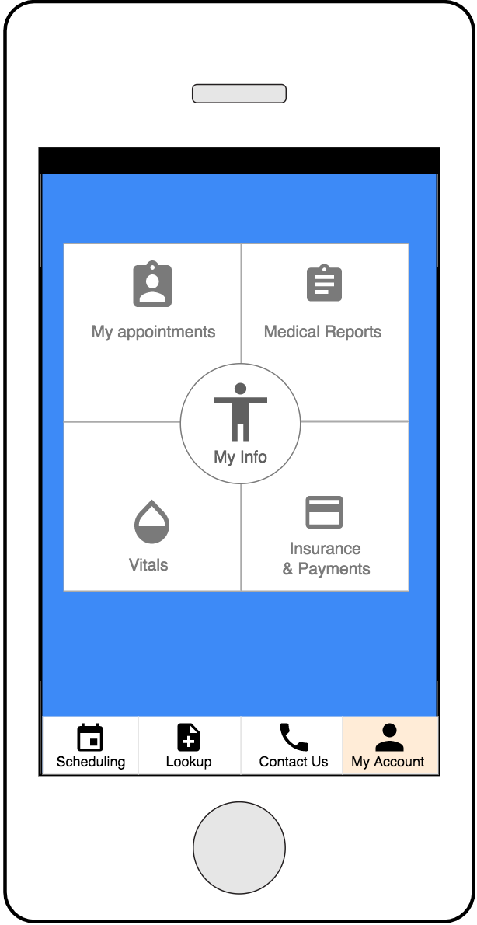
Background
With all the advances in technology, an ‘Intelligent Health Assistance’ app is the need of hour
It must be a consolidation for all the features which are provided by apps of disparate but related nature
With advancements it is supposed to be an assistant with intelligent decision making for you

Slide 4
Our Solution
Appointment booking at your fingertips with doctors of your choice
Hassle free solution to find doctors and medication as per your requirement
Tracking of follow up meeting and real-time queue info
One single user profile linked to medical reports, insurance, payment, appointment details and vital stats
Emergency alert based on location tracking
Ecosystem binding all entities in Healthcare Management System
Tutorial video for the users to learn about the features of the app
Different interface of the application for Doctors
Doctors can manage their workday schedule, update follow up meetings, check reports of their patients and access their reviews and ratings
Access to medical information of patients through locked screen in case of emergency
SOS button in the global navigation if the user choses to enable it.

Slide 5
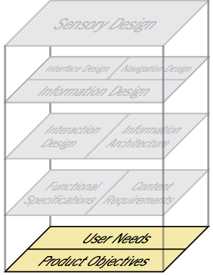
Strategic Plane
Product Objective:
Followed card sorting technique (could have, should have and must have).
Putting up requirements under proper buckets so that it is easier to understand the structure of the app, decide categories and navigate.
Brand Identity:
Focused on creating a good impression of the app.
The user might get confused and exit the application if provided with too many options at the home page resulting in bounce rate of the app to skyrocket.
User Segmentation:
UI design is simple enough to be used by people from every age group.
User Research:
Conducted surveys and interviews for better understanding of user needs.
Notes:
Keeping Strategic plane and brand identity in mind we have kept our IA limited to few option so that the user doesn't get lost on the app

Slide 6
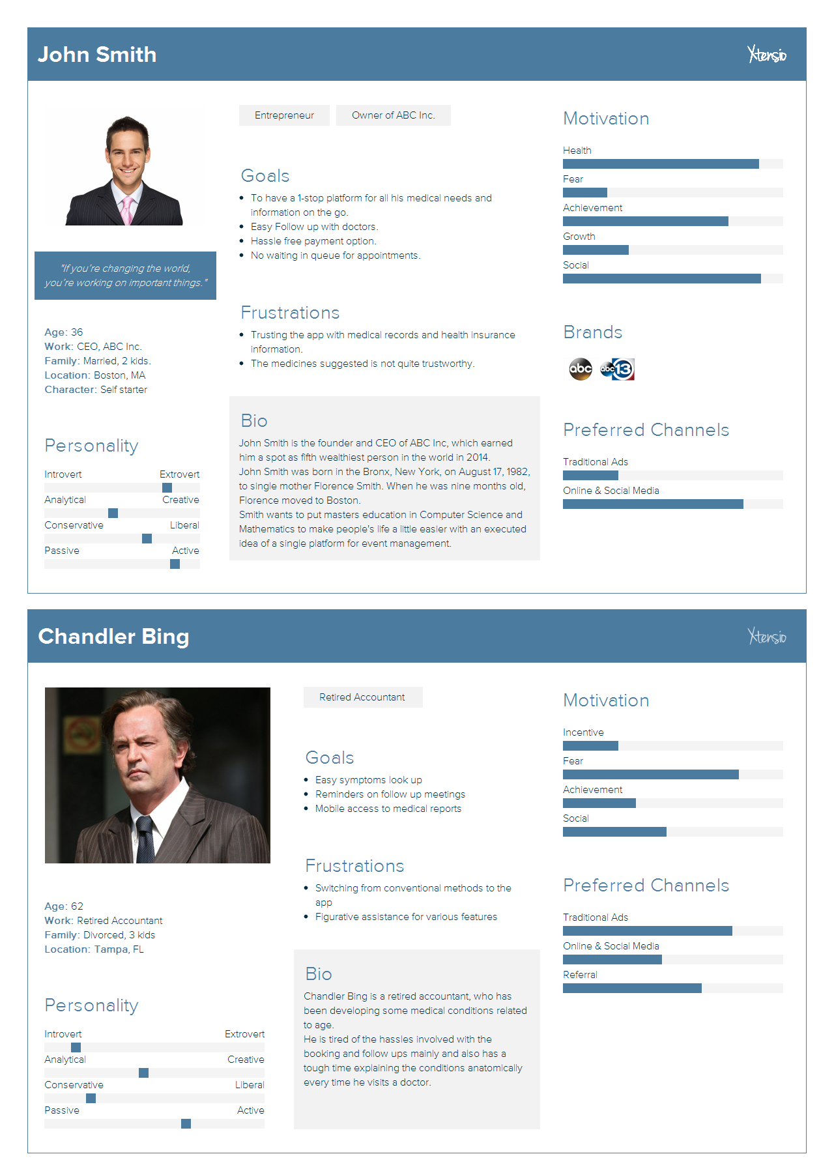
User Personas
Persona 1:
A younger professional
Pro mobile app
Persona 2:
An older person
Anti mobile app

Slide 7
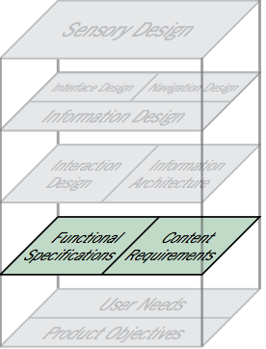
Scope Plane
Defining Requirements for different user groups
16-30 | 31-45 | 46-75
Browse for symptoms/medicine | Schedule appointments | 31-45, +
Track vital signs | Check reports | Auto reminders and follow ups
Contact/chat with representatives | Insurance information linking | 1 time payment set up

Slide 8
Scope Plane (contd.)
Content Requirement:
Visual aids
Tour of the app
Pdf of reports
FDA Regulated medical information
Prioritizing Requirements:
Tried to strike a balance between ‘global nav options’ vs ‘user norms’

Slide 9
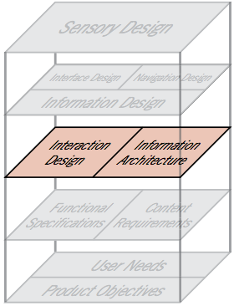
Structure Plane
Interaction Design
The app responds seamlessly to any user where the navigation options are intuitive
The options in the app are consistent with all specific features
The conceptual model here is like a catalog for the user to explore
Also, There is a tour option always available for users to get familiar with all the features and power of the app

Slide 10
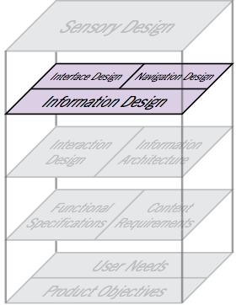
Skeleton Plane
Interface Design
The interface of the app has been designed to let users notice important features of the app
Navigation Design
The global navigation option in the app makes it easier for the users from all age group to navigate to the features they want access to.
The local navigation gives users the power to access nearby features like anatomical lookup and multiple options in user account as info, vitals etc.
Information Design
The color coding, icons and labels used are conventional and intuitive for efficient wayfinding

Slide 11
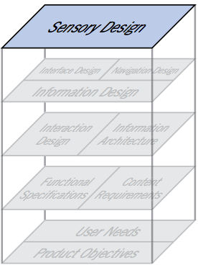
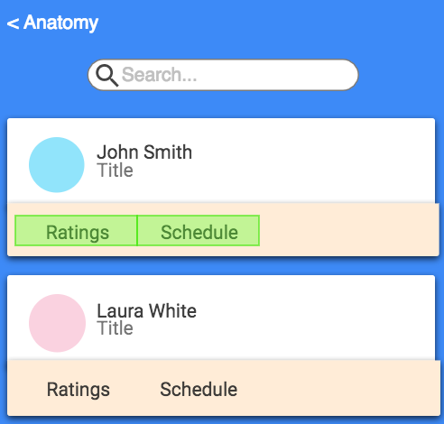
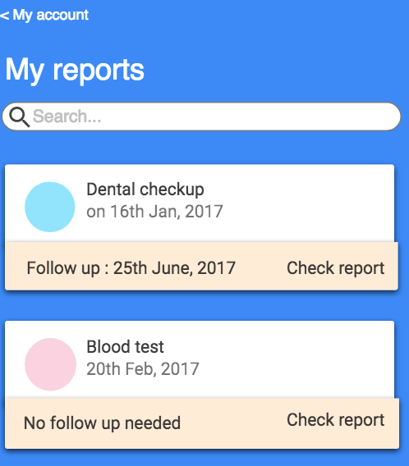
Surface Plane
Consistency
Card approach to any sort of selection in app
The application follows same recurring design patterns throughout
Contrast
The colors and contrast used are standard and doesn't look sore to the eyes when a user opens an application

Slide 12
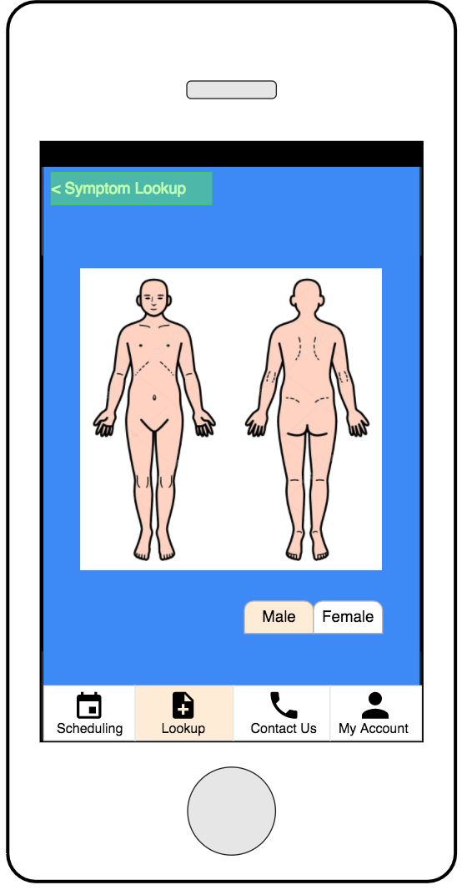
Following the eye : Initial testing of the application
Users focused their attention on images during symptoms look up rather than texts.
The average time spent on the symptom look up page was 22.8 seconds.
4 on 5 users preferred to navigate through the icons on the home screen

Slide 13
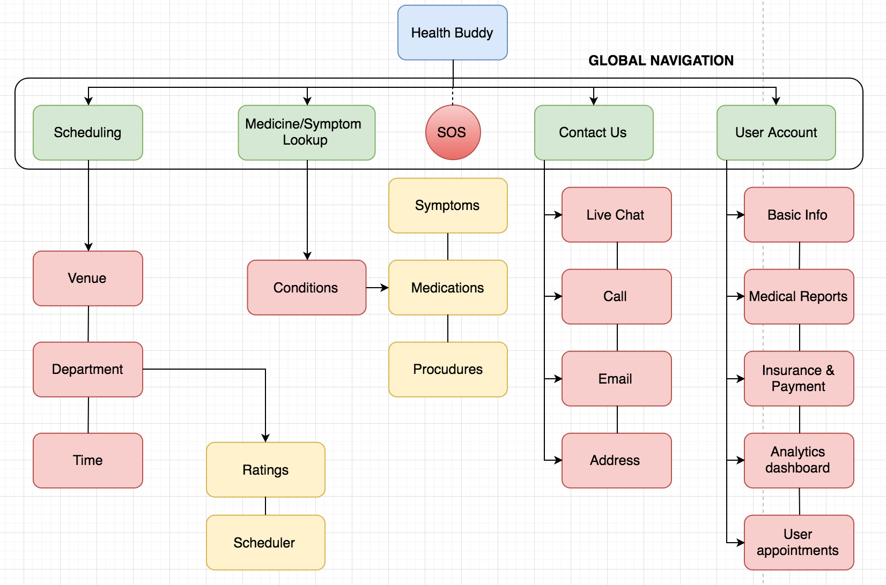
Information Architecture for Users

Slide 14
Introducing Doctors workflow
Manage their workday schedule to make appointments through the app
Option to schedule follow up meeting for patients
Look up and enroll option for upcoming meetings, events or seminars
Access to test reports of their patients and patient history

Slide 15
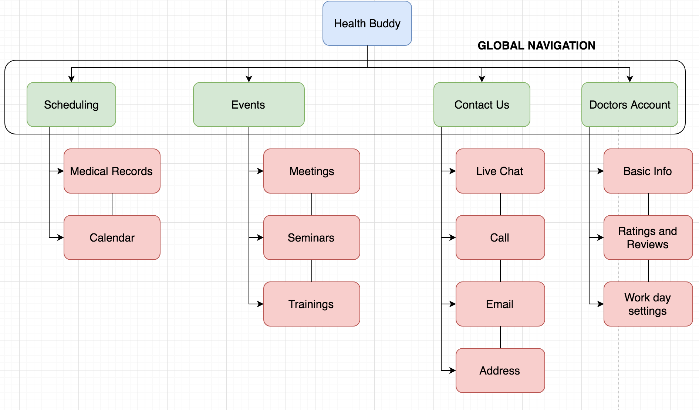
Information Architecture for Doctors

Slide 16
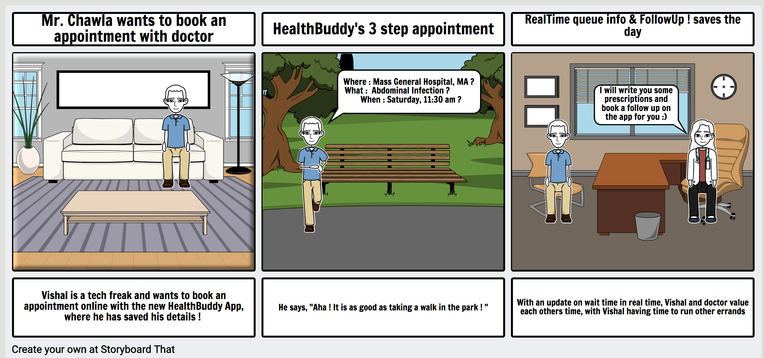
Storyboard 1: Scheduling

Slide 17
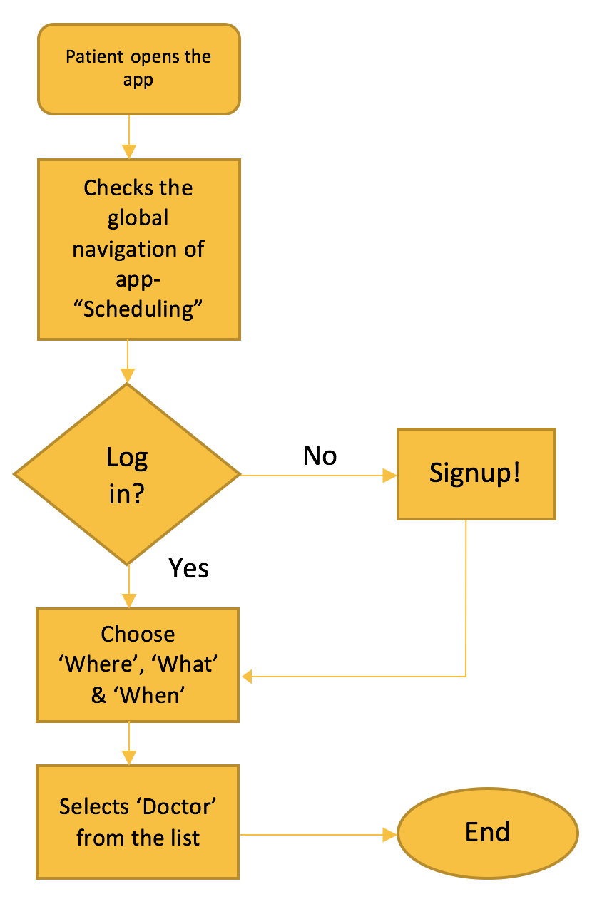
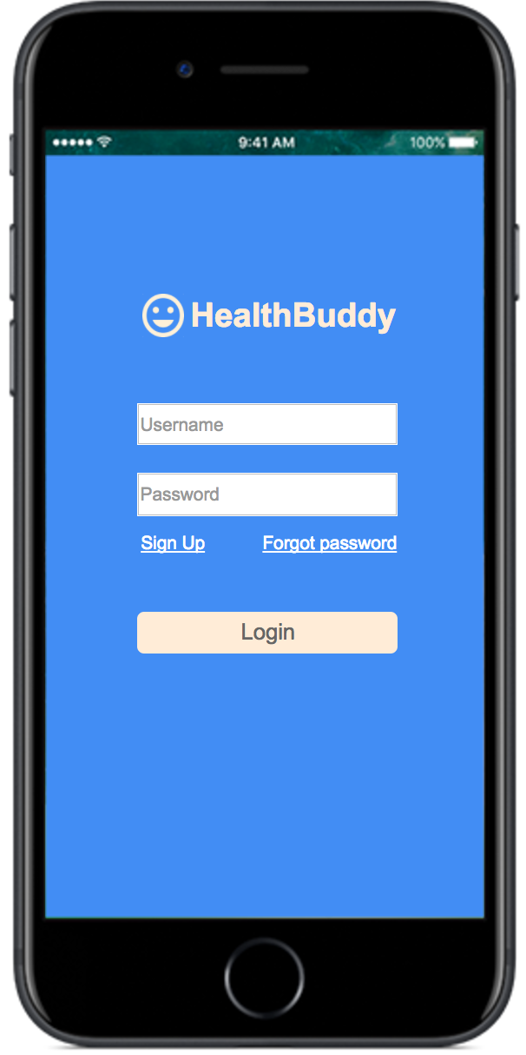
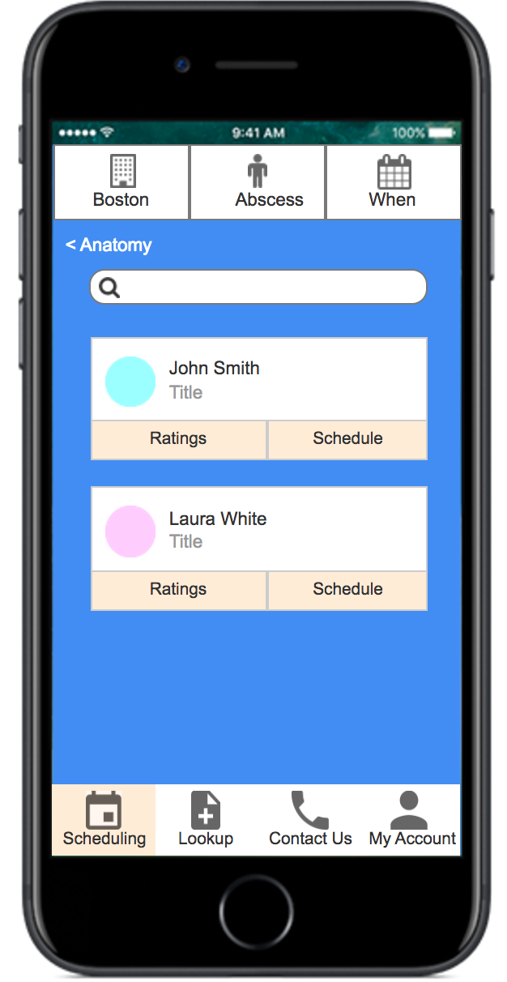
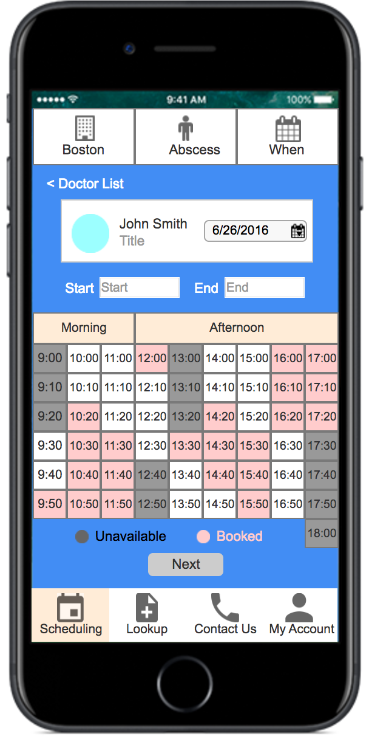
Workflow 1

Slide 18
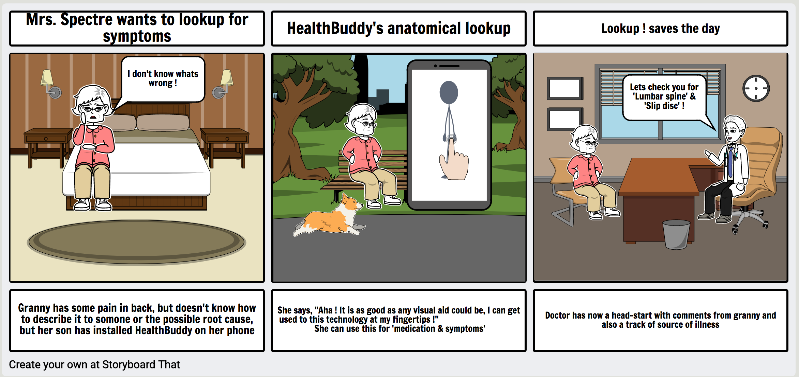
Storyboard 2: Look up

Slide 19
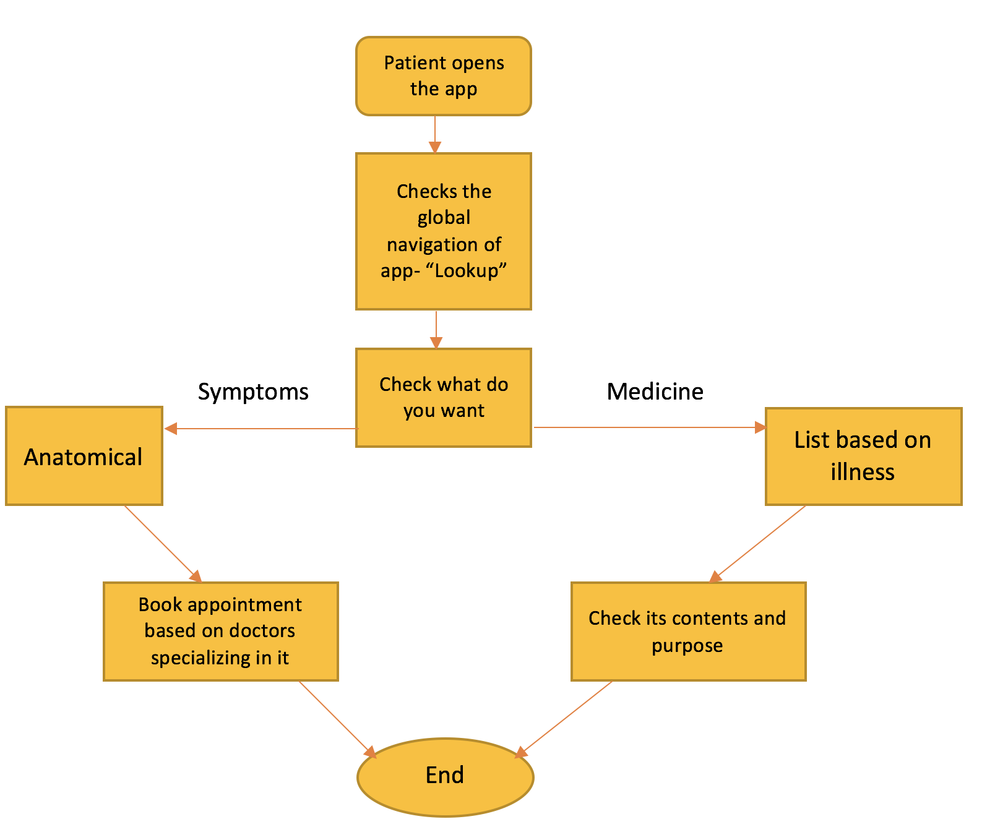
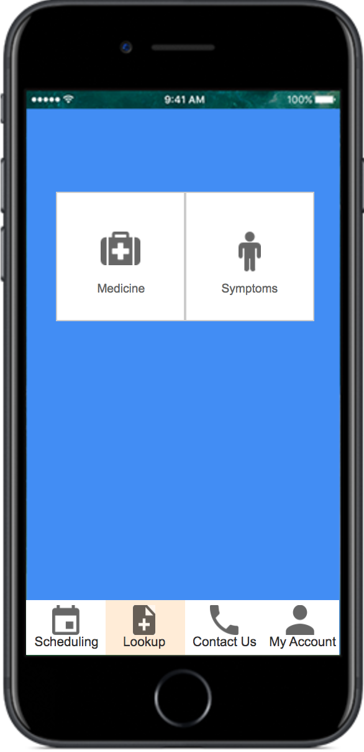
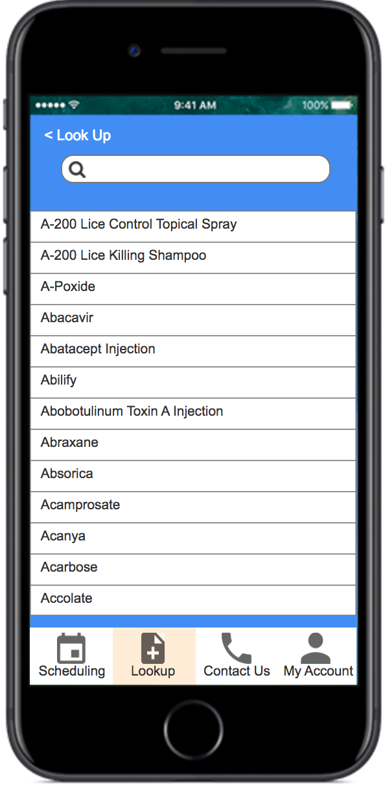
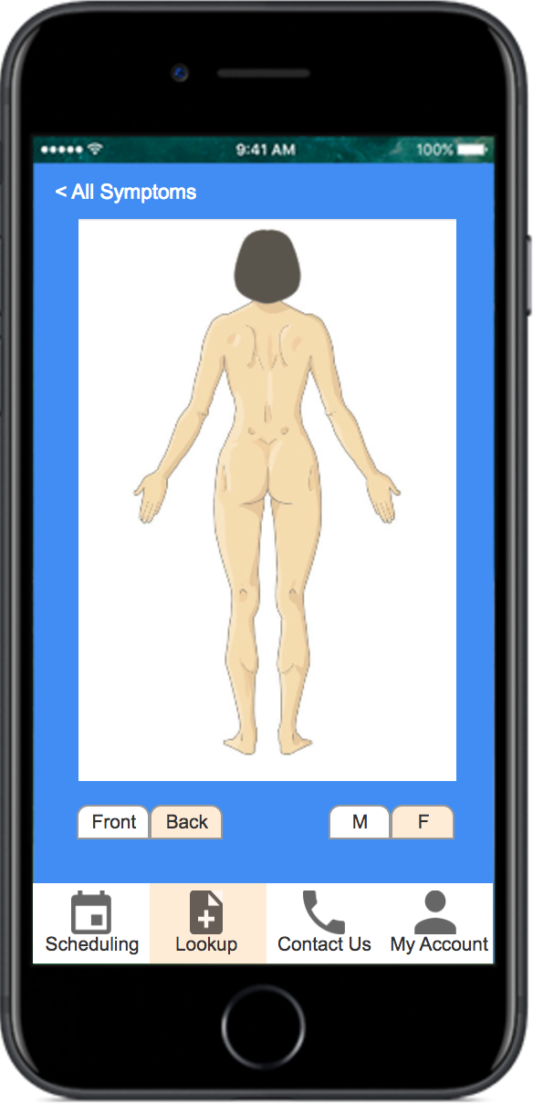
Workflow 2

Slide 20
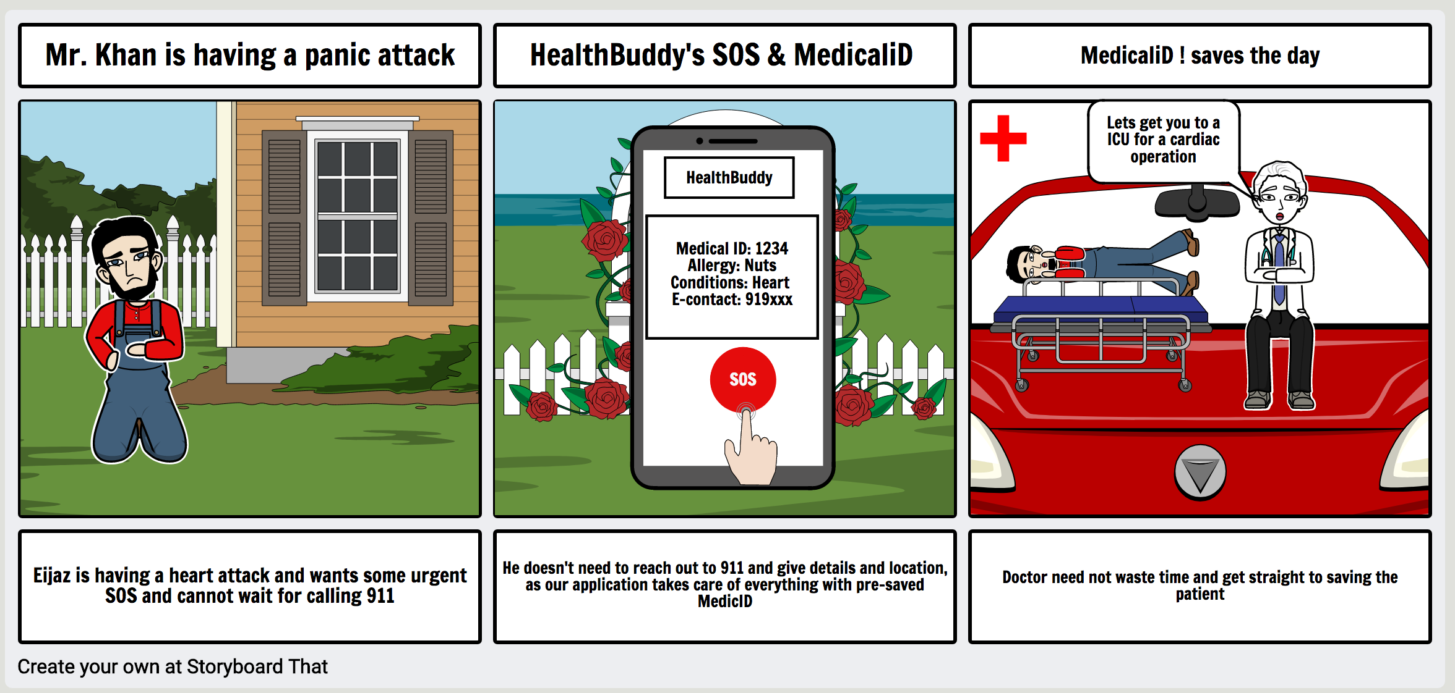
Storyboard 3: Medical iD & SOS

Slide 21
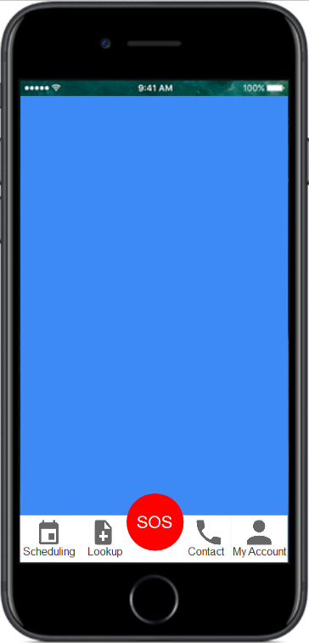
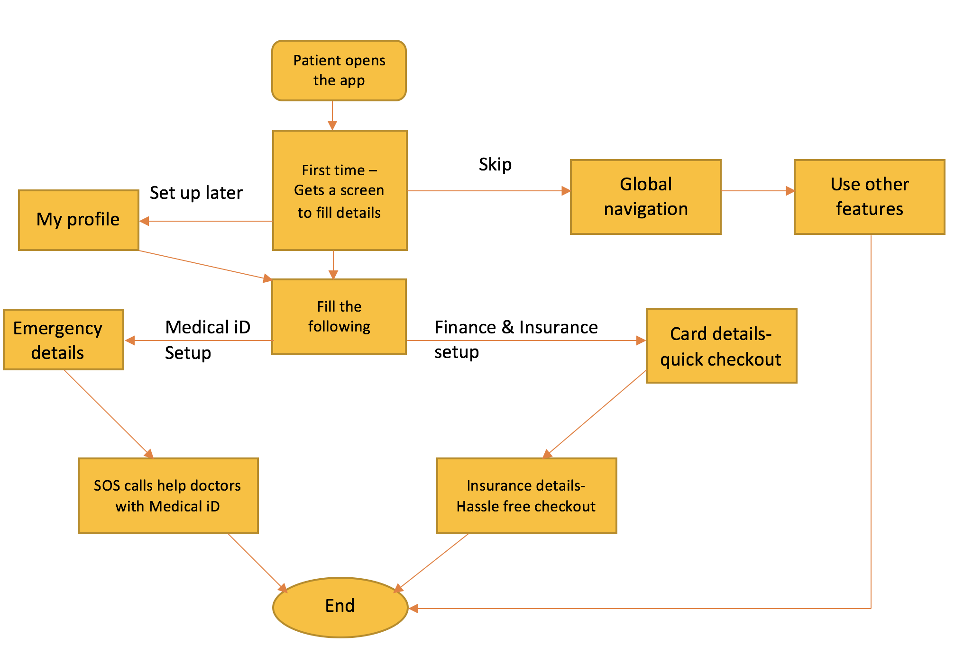
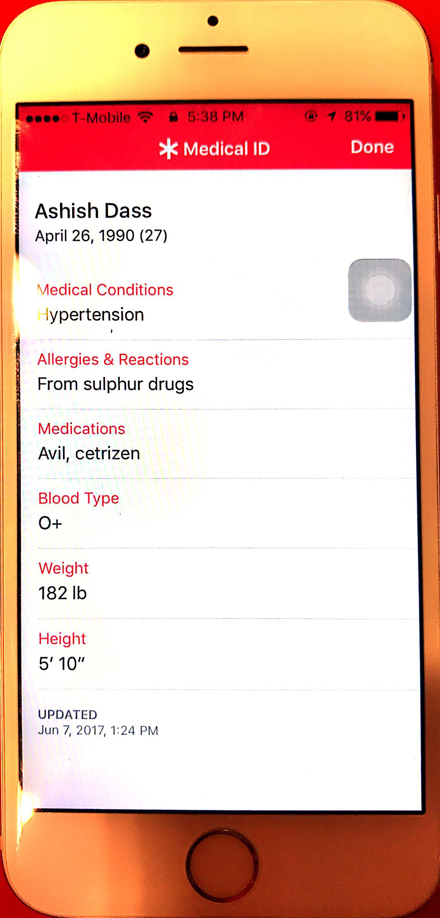
Workflow 3

Slide 22
UX Research Methods
Behavioral
Usability Testing
Clickstream Analysis
User Feedback
Card Sorting
Eye Tracking
A/B Testing
Email Survey
Attitudinal
Qualitative
Quantitative

Slide 23
1. Usability Testing
Book an appointment for June 26th 2017 at 10 am
Look up probable causes for abdominal pain and book an appointment alongside
Check you last updated vital records
Y | N | Y | Y | Y
18s | Person expecting a search button | 16s | 19s | 26s
Y | Y | Y | Y | Y
20s | 28s | 22s | 25s – Was not sure about feature | 20s
Y | Y | Y | Y | Y
3s | 4s | 8s – Had not explored the app | 5s | 6s

Slide 24
Check the schedule of your next follow up meeting with your doctor
Check if you have any new medical report results in your account
Y | Y | Y | Y | Y
5s | 7s | 6s | 9s | 8s
Y | Y | Y | Y | Y
3s | 11s – Had not explored the app | 4s | 4s | 7s

Slide 25
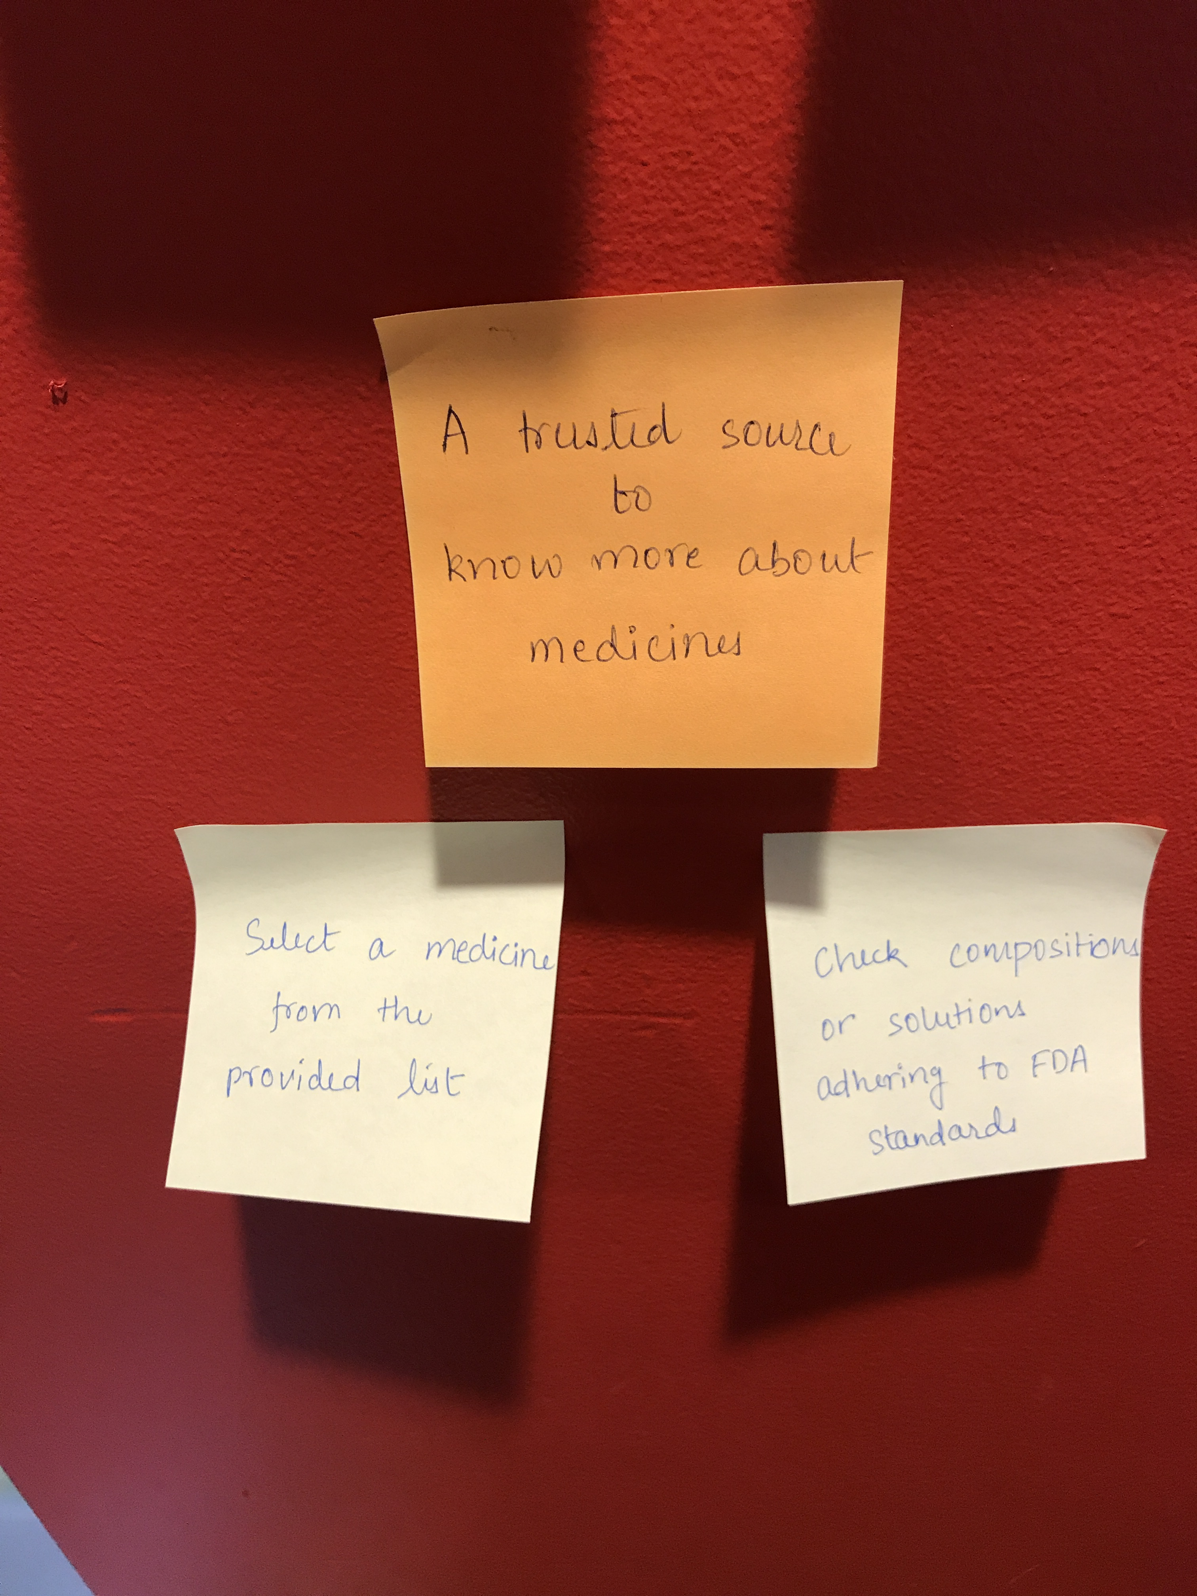
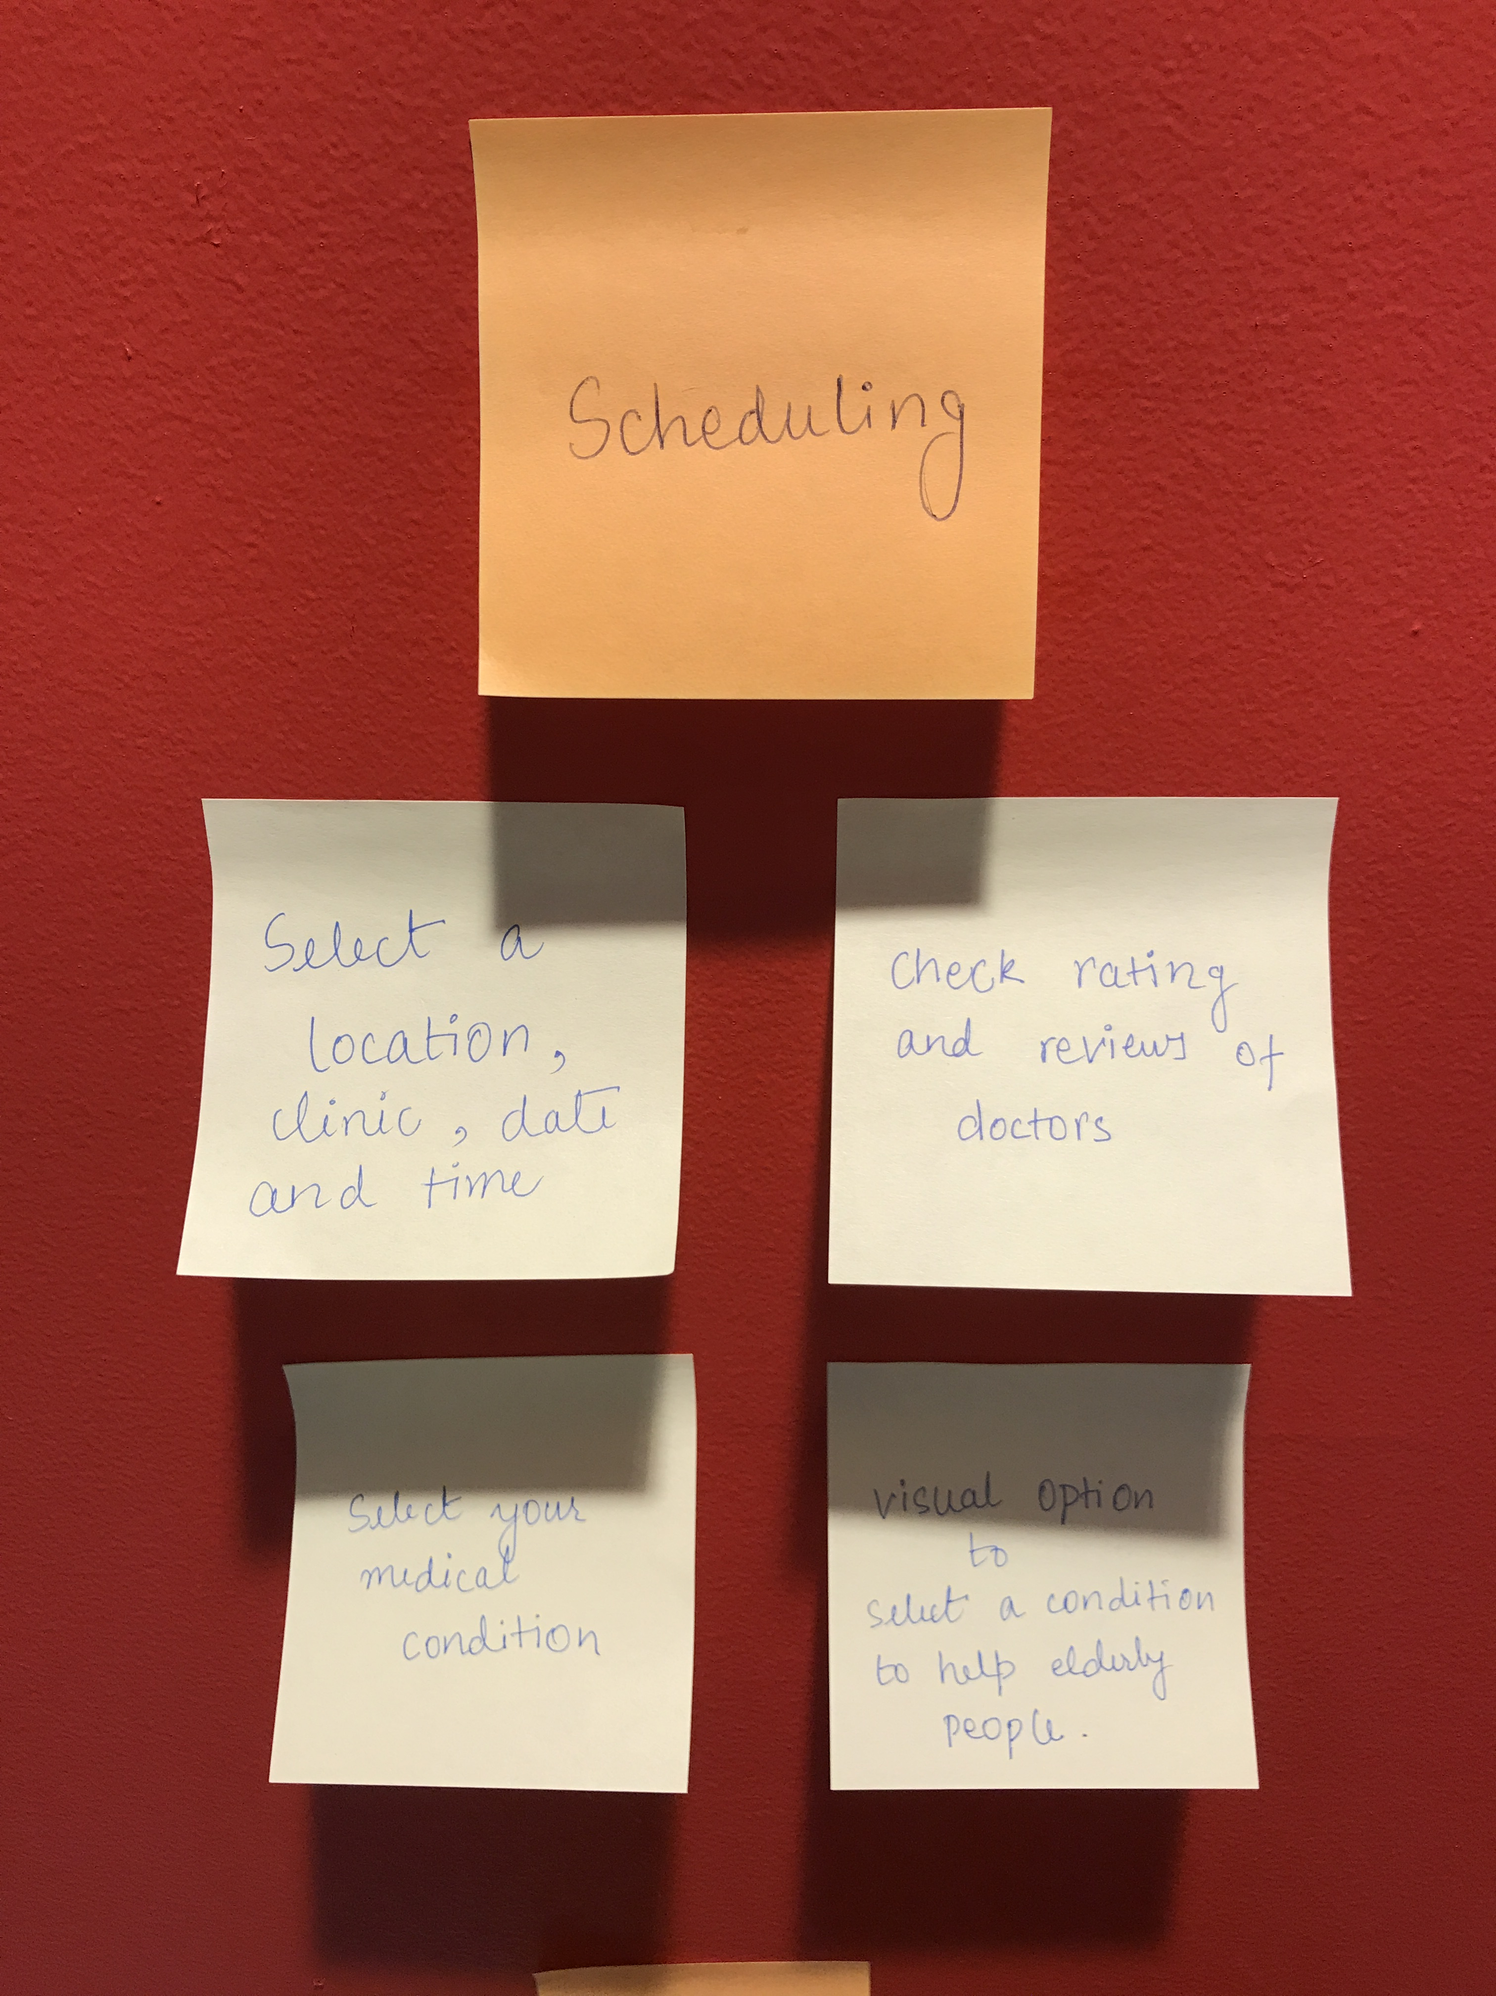
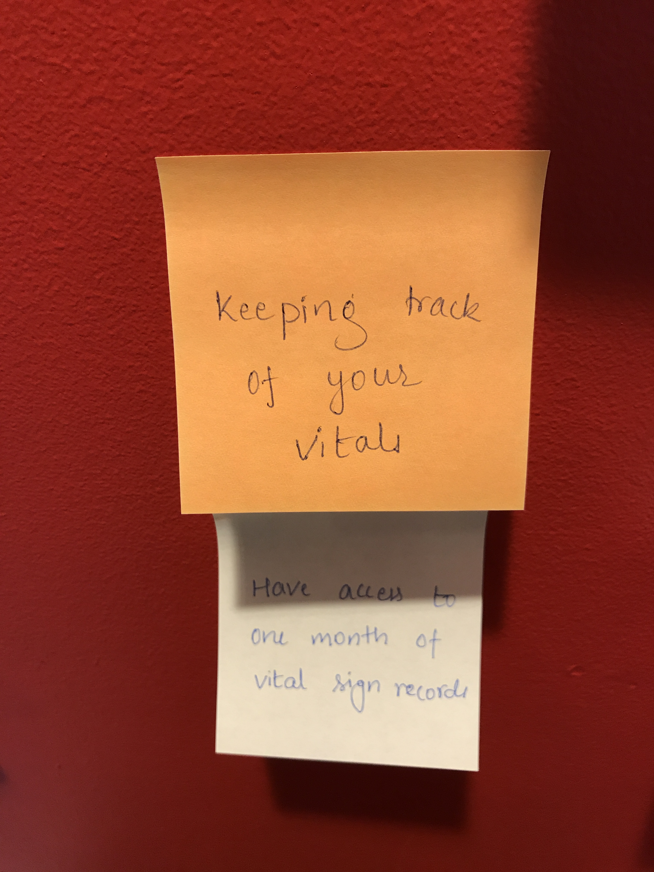
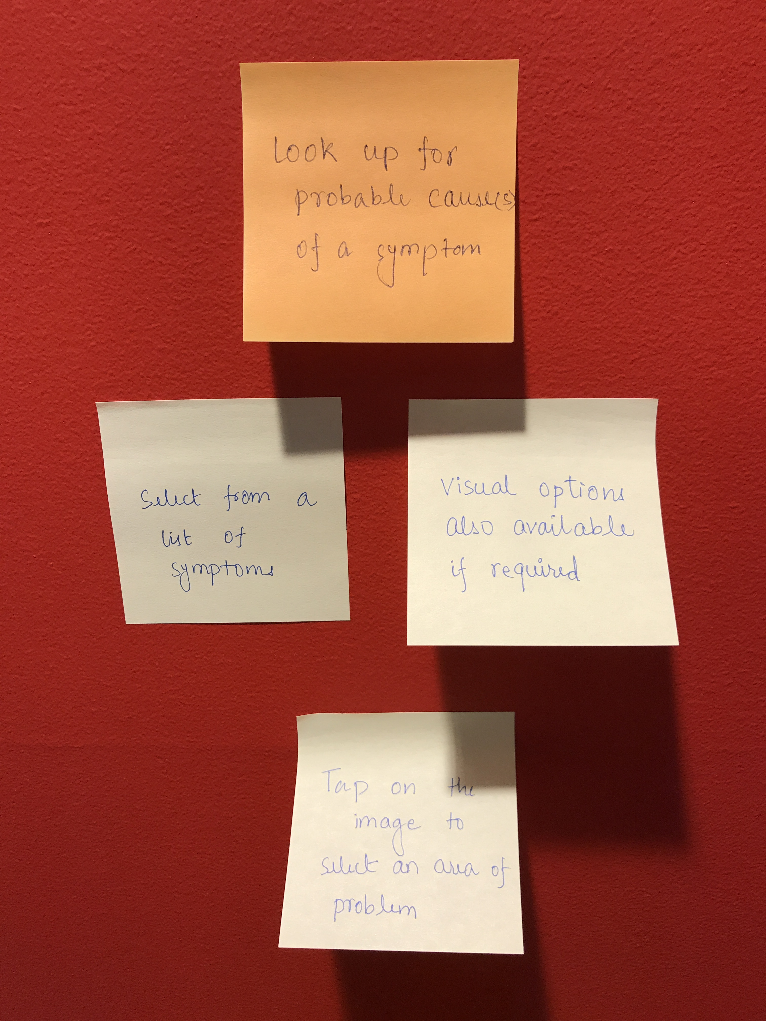
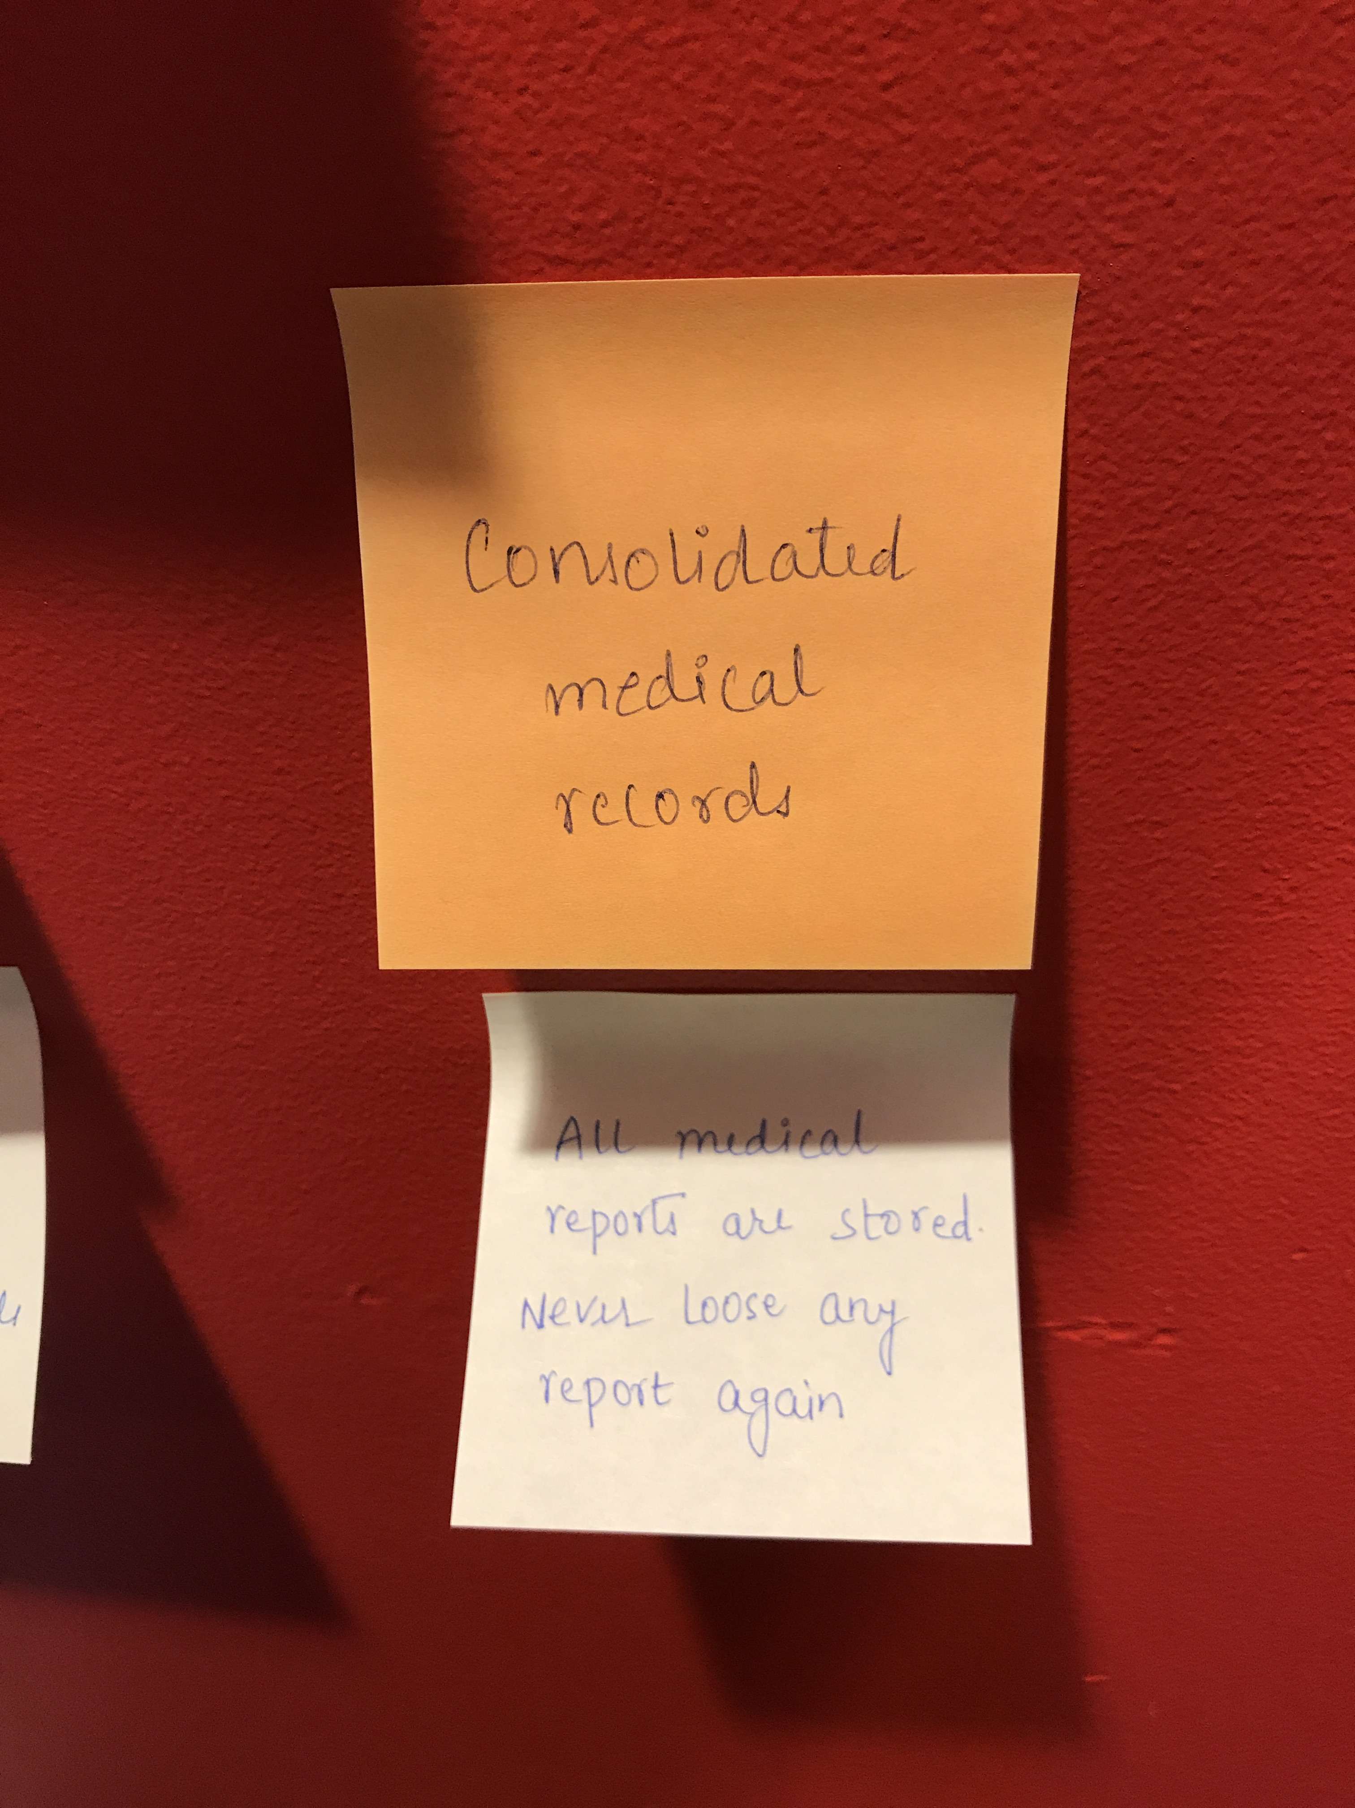
2. Card Sorting

Slide 26
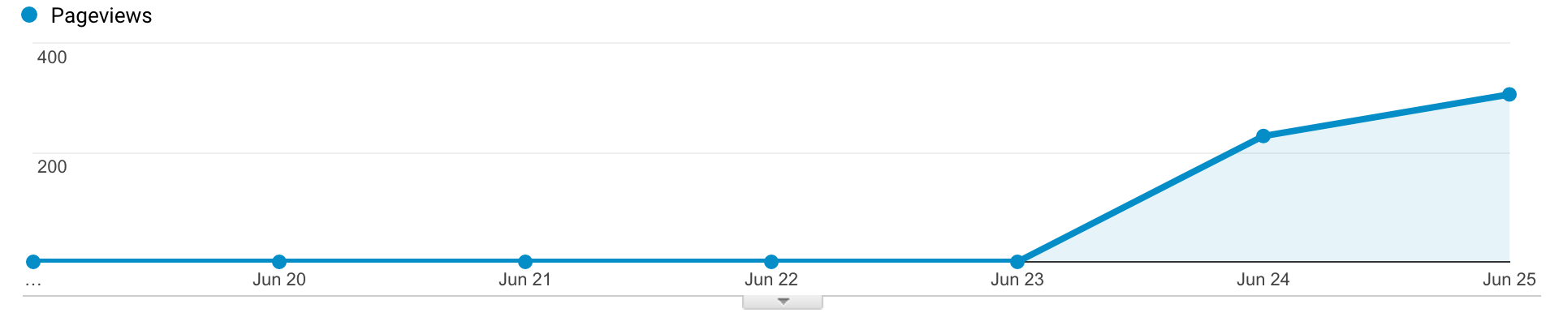
3. A/B Testing
We introduced an API integration for 3rd party apps to track vital signs through various wearable devices
Observed that Vitals was the 1st accessed feature by 90% of users.
This accelerated the usage of our app as a utility and page view peaked up by 31%
Notes:
A/B testing presents changes to a site's design to random samples of site visitors
To see the effect of different site-design choices on behavior

Slide 27
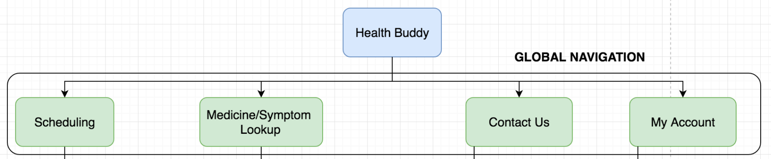
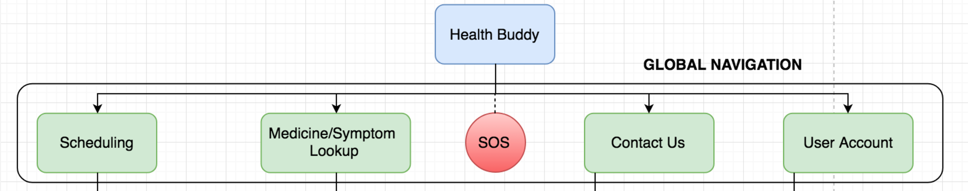
We discussed introducing a SOS button to the global navigation menu for emergency calling
People gave positive feedback about this feature

Slide 28





4. Survey Results
Most valued feature of the app
Scheduling Appointments
Vital Signs tracking
Medicine Lookup
Doctors Lookup
Follow up meeting

Slide 29
How likely you will recommend this app to your friend?

Slide 30
User Feedbacks
Users wanted a ‘next’ option in tutorial or a carousel effect
‘Search’ button in scheduling can feel more intuitive
Making the ‘try me’ option more prominent
‘SOS’ can be placed under ‘Contact Us’
Better filter options under ‘My appointments’ in My Account

Slide 31
App Demo

Slide 32
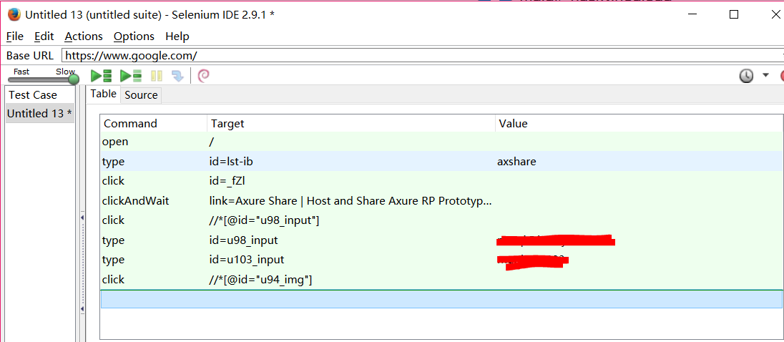
QA Testing - Selenium
Performed Selenium testing for few of our workflows and did an assertTextPresent check option using the validation feature of the app.

Slide 33
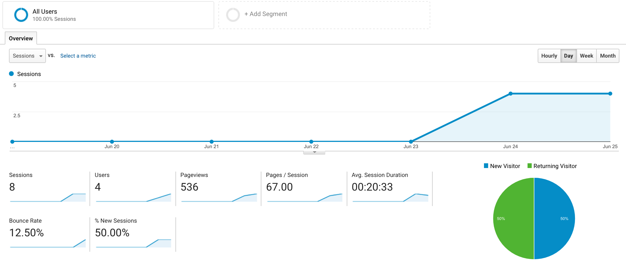
Clickstream Analysis (Google Analytics)
Users Overview

Slide 34
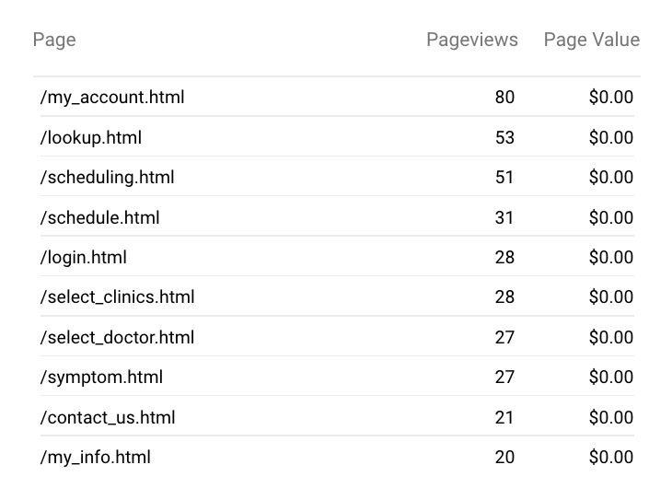
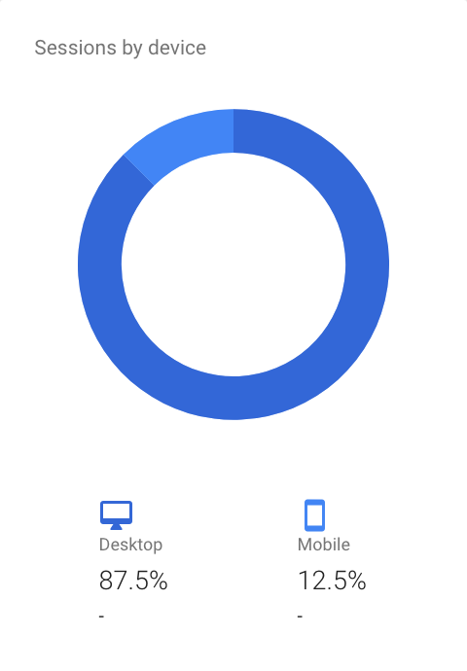
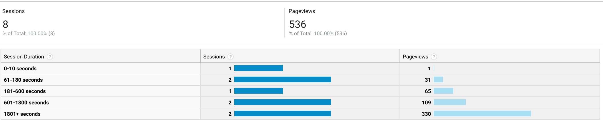
Popular features
Accessibility
User engagement

Slide 35
Reflections
Best Features
Tutorial video of the app
Image assistance in symptom look up
Medical ID on lock screen and SOS button
Doctors booking follow up appointments for patients
Points that took hard work
The user flow design and navigation of ‘Scheduling’.
The arrangement of information in ‘User Account’.
The ‘Information Architecture’ of doctor part which should be consistent with the patients part.
Future works
Add SOS button according to A/B testing results and do more testing, basically about where it should be put.
Improve the filter options in “My Appointments” under User Account.

Slide 36

Thank you !

